Slide 1
Modular Programming(4-dars)
Davronbek Malikov

Slide 2
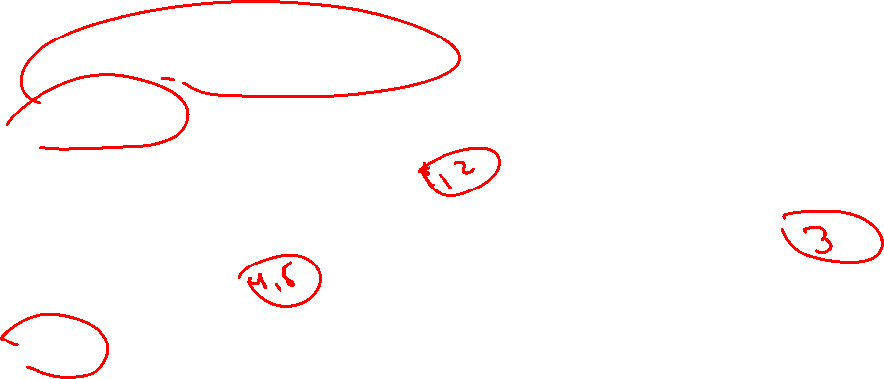
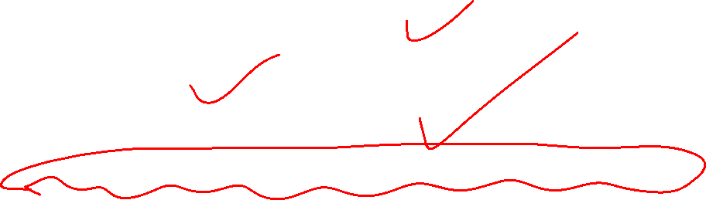
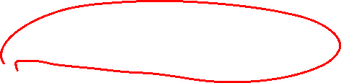

Bugun
Project 2 xolati+ Savol javob
Takrorlash
Data Extraction va merging
Githubdagi Projectni gitga ulash va yangi commands
Logging va error
Vazifa

Slide 3
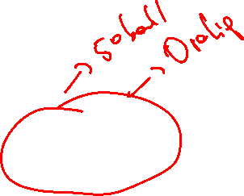
Project 2 xolati va savol javob

Slide 4
Takrorlash

Slide 5

Takrorlash
Project 1 + Modular Structure(yakuniy xolat)
Takrorlash
Folder Structure review
Git-Bash ichkari
Virtual Environment
Virtual Environment yaratish
Data Extraction
Vazifa

Slide 6
Data Extraction va merging

Slide 7
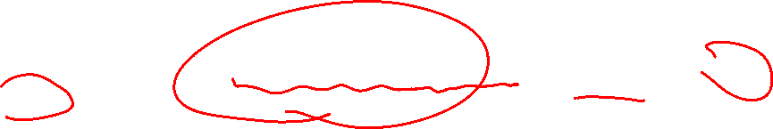

Data Extraction va merging
Data Extraction
Turli xil websitelardan etiketga rioya qilgan xolda malumotlarni tortib olish processi

Slide 8
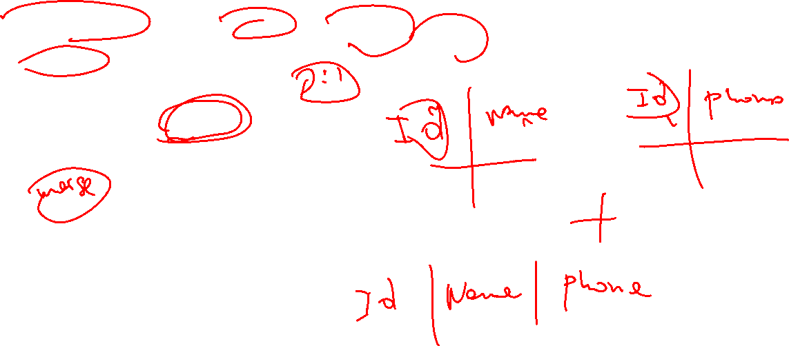


Data Extraction va merging
Turli xil xolatdagi datasetlarni birlashtirib yagona dataset xosil qilish—merging
Usullari:
Bir xil ustunlar (concat)
Join(comman key:join/merge)

Slide 9

Data Extraction va merging
Data Extraction amaliy
Data merging amaliy

Slide 10
Githubdagi Projectni gitga ulash va yangi commands

Slide 11


Githubdagi Projectni gitga ulash
Clonning
Desktopga folderni auto yaratadi
Qolgani eski xolatda(git push)

Slide 12

Logging va error

Slide 13
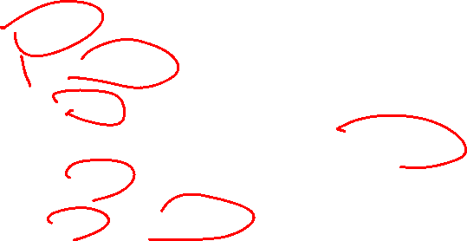
Logging va error
Kodlar yozilganda turli xil xolatlar bo’ladi:
Warnings
Errors
Kodingni nazorat qilishni 2 ta asosiy yo’li mavjud
Logging
Errros(Exceptions)

Slide 14
Logging va error
Logging
Program run bo’lgunicha bo’lgan jarayonlarni (xodisalarni) saqlab boradigan file
Foydasi
Debug
Monitor
audit

Slide 15
Logging va error
Xabarlar turli xil darajada bo’ladi:
DEBUG---Muammo xaqida chuqurroq malumot
INFO—Program xaqida umumiy malumot beradi
WARNING—Kodlar run bolishda davom etadi, lekin kutilmagan nimadir sodir bo’lganini korsatadi
ERROR-Jiddiy muammo
CRITICAL- Programma toxtaydi juda jiddiy muammo

Slide 16
Logging va error
Xabarlar turli xil darajada bo’ladi:
DEBUG---Muammo xaqida chuqurroq malumot
INFO—Program xaqida umumiy malumot beradi
WARNING—Kodlar run bolishda davom etadi, lekin kutilmagan nimadir sodir bo’lganini korsatadi
ERROR-Jiddiy muammo
CRITICAL- Programma toxtaydi juda jiddiy muammo

Slide 17
Logging va error
Errorlar--- runtime problem bu normal bolgan ishlanri toxtadi
SyntaxError – code is invalid
TypeError – wrong type of variable
FileNotFoundError – missing file
ValueError – invalid value for a function

Slide 18
Logging va error
Errorlar--- runtime problem bu normal bolgan ishlanri toxtadi
SyntaxError – code is invalid
TypeError – wrong type of variable
FileNotFoundError – missing file
ValueError – invalid value for a function

Slide 19
Vazifa
Final Project uchun data collectionni boshlang(web scraping orqali)
Report yozing
O’tilgan barcha commandslarni yozing va Rasmini yuklang
Problem solvingni kuchaytiring(codewars, leedcode)
Monkeytype(tezlik)

